Slide 1
University Of Diyala
College Of Engineering
Computer Engineering Department
Modeling Sequential Logic in VHDL
Dr. Yasir Amer Abbas
Third stage
2017

Slide 2
In this lecture
Synchronous sequential logic circuits rely on storage elements for their operations.
Flips-flops (FFs) and latches are two commonly used one-bit elements.
Others as registers, shift registers, and counters.
Only synchronous sequential logic is considered.

Slide 3
LATCHES & FLIP-FLOPS
A latch is a level-sensitive memory device (transparent).
As long as the pulse remains at the active high level, any changes in the data input will change the state of the latch.
A flip-flop (FF) is an edge-triggered memory device.
An edge-triggered FF ignores the pulse while it is at a constant level (non-transparent).
Triggers only during a transition of the clock signal.
Could on the positive edge of the clock (posedge), or negative edge (negedge).

Slide 4
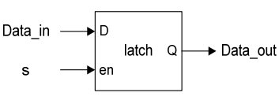
Simple Latch
D Latch
⋅ A latch is inferred because the IF statement is incomplete.
⋅ The notion of implied memory is instantiated in this case.
…
always (S or Data_In)
if ( S )
Data_out = Data_In;
…..

Slide 5
Simple Latch
library ieee ;
use ieee.std_logic_1164.all;
entity D_latch is
port(
data_in: in std_logic;
enable: in std_logic;
data_out: out std_logic );
end D_latch;
architecture behv of D_latch is
begin -- compare this to D flipflop
process(data_in, enable)
begin
if (enable='1') then -- no clock signal here
data_out <= data_in;
end if;
end process;
end behv;

Slide 6
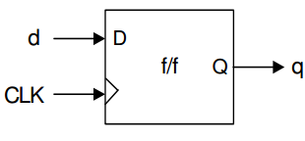
Basic positive-edge triggered D flip-flop

Slide 7
Flip-flop is the basic component
library ieee ;
use ieee.std_logic_1164.all;
entity dff is
port(
data_in: in std_logic;
clock: in std_logic;
data_out: out std_logic );
end dff;
Architecture behv of dff is
begin
process(data_in, clock) .
begin -- clock rising edge
if (clock='1' and clock'event) then
data_out <= data_in;
end if;
end process;
end behv;

Slide 8
VHDL code for Rising Edge D Flip Flop
Library IEEE;
USE IEEE.Std_logic_1164.all;
entity RisingEdge_DFlipFlop is
port(
Q : out std_logic;
Clk :in std_logic;
D :in std_logic );
end RisingEdge_DFlipFlop;
Architecture Behavioral of RisingEdge_DFlipFlop is
begin
process(Clk)
begin
if(rising_edge(Clk)) then
Q <= D;
end if;
end process;
end Behavioral;

Slide 9
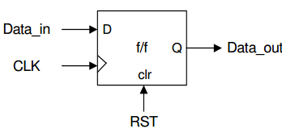
VHDL code for Rising Edge D Flip-Flop with Synchronous Reset
Library IEEE;
USE IEEE.Std_logic_1164.all;
entity RisingEdge_DFlipFlop_SyncReset is
port(
Q : out std_logic;
Clk :in std_logic;
sync_reset: in std_logic;
D :in std_logic );
end RisingEdge_DFlipFlop_SyncReset;
Architecture Behavioral of RisingEdge_DFlipFlop_SyncReset is
begin
process(Clk)
begin
if(rising_edge(Clk)) then
if(sync_reset='1') then
Q <= '0';
else Q <= D;
end if;
end if;
end process;
end Behavioral;

Slide 10
VHDL code for Rising Edge D Flip-Flop with Asynchronous Reset High Level
Library IEEE;
USE IEEE.Std_logic_1164.all;
entity RisingEdge_DFlipFlop_AsyncResetHigh is
port(
Q : out std_logic;
Clk :in std_logic;
sync_reset: in std_logic;
D :in std_logic );
end RisingEdge_DFlipFlop_AsyncResetHigh;
Architecture Behavioral of RisingEdge_DFlipFlop_AsyncResetHigh is
begin
process(Clk,sync_reset) .
begin
if(sync_reset='1') then Q <= '0';
elsif(rising_edge(Clk)) then
Q <= D;
end if;
end process;
end Behavioral;

Slide 11
n-bit Register
library ieee ;
use ieee.std_logic_1164.all;
use ieee.std_logic_unsigned.all;
entity reg is
generic(n: natural :=2);
port(
I: in std_logic_vector(n-1 downto 0);
clock: in std_logic;
load: in std_logic;
clear: in std_logic;
Q: out std_logic_vector(n-1 downto 0) );
end reg;
Architecture behv of reg is
signal Q_tmp: std_logic_vector(n-1 downto 0);
begin
process(I, clock, load, clear)
begin
if clear = '0' then -- use 'range in signal assigment
Q_tmp <= (Q_tmp'range => '0');
elsif (clock='1' and clock'event) then if load = '1' then
Q_tmp <= I;
end if;
end if;
end process; -- concurrent statement
Q <= Q_tmp;
end behv;

Slide 12
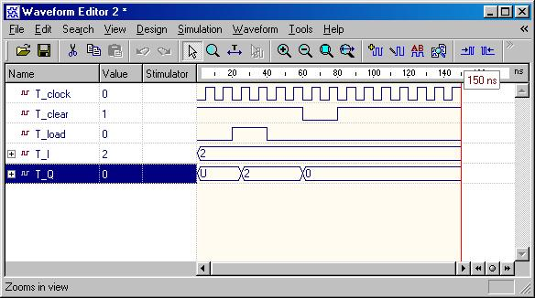
Simulation N bit register

Slide 13
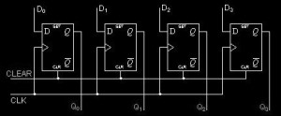
Parallel In – Parallel Out Shift Registers
library ieee;
use ieee.std_logic_1164.all;
entity pipo is
port(
clk : in std_logic;
D: in std_logic_vector(3 downto 0);
Q: out std_logic_vector(3 downto 0)
);
end pipo;
architecture arch of pipo is
begin
process (clk)
begin
if (CLK'event and CLK='1') then
Q <= D;
end if;
end process;
end arch;

Slide 14
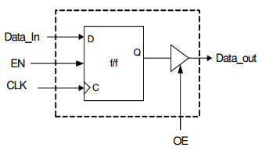
H.W: design Flip-flop with a tri-state output using VHDL code

Slide 15
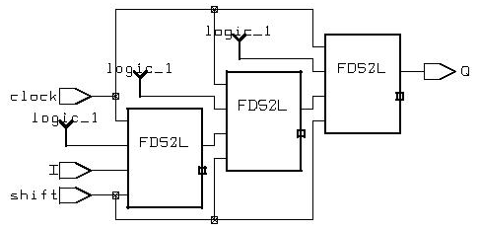
Shift Register
library ieee ;
use ieee.std_logic_1164.all;
---------------------------------------------------
entity shift_reg is
port(
I: in std_logic;
clock: in std_logic;
shift: in std_logic;
Q: out std_logic );
end shift_reg;
---------------------------------------------------
Architecture behv of shift_reg is -- initialize the declared signal
signal S: std_logic_vector(2 downto 0):="111";
begin
process(I, clock, shift, S)
begin -- everything happens upon the clock changing
if clock'event and clock='1' then
if shift = '1' then
S <= I & S(2 downto 1);
end if;
end if;
end process; -- concurrent assignment
Q <= S(0);
end behv;

Slide 16
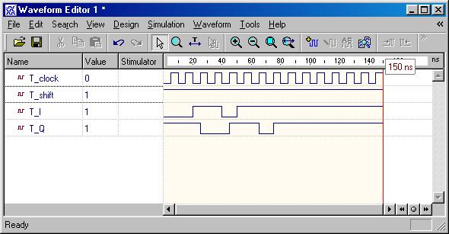
Simulation Waveform Shift Register

Slide 17
Counter
library ieee ;
use ieee.std_logic_1164.all; use ieee.std_logic_unsigned.all;
----------------------------------------------------
entity counter is
generic(n: natural :=2);
port(
clock: in std_logic;
clear: in std_logic;
count: in std_logic;
Q: out std_logic_vector(n-1 downto 0) );
end counter;
----------------------------------------------------
architecture behv of counter is
signal Pre_Q: std_logic_vector(n-1 downto 0);
begin -- behavior describe the counter
process(clock, count, clear)
begin
if clear = '1' then Pre_Q <= Pre_Q - Pre_Q;
elsif (clock='1' and clock'event) then
if count = '1' then Pre_Q <= Pre_Q + 1;
end if;
end if;
end process; -- concurrent assignment statement
Q <= Pre_Q;
end behv;

Slide 18
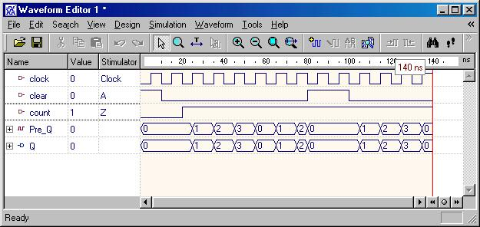
Counter

Slide 19
Exercise:
⋅ Sketch the iobd of this universal shift register
⋅ Obtain its functional block diagram in terms of FFs and the associated glue logic.
Synchronous Counters
Example : A 5-bit up-counter with a parallel load
module upcount5 ( data, Q, clk, rst, ld, inc) ;
input [4:0] data ;
output[4:0] Q ;
input clk, rst ;
input ld, inc ;
reg[4:0] Q ;
always @( posedge rst or posedge clk )
if( rst ) Q <= 0 ;
else if ( ld ) Q <= data ;
else if ( inc ) Q <= Q + 1;
endmodule

Slide 20
Finite State Machine (FSM)
⋅ A circuit type with memory.
⋅ Usually as datapath controller unit.
⋅ Via algorithmic state machine (ASM) flowchart, an FSM is readily modeled in HDL.
⋅ There are two basic models of FSMs: Moore and Mealy.
⋅ In a Mealy machine, the next state (NS) and the outputs depend on both the present state (PS) and the inputs.
⋅ The NS of a Moore machine depends on the PS and the inputs, but
the outputs depend on only the PS.
⋅ All FSMs have the general feedback structure.
⋅ We will deal only with synchronous FSMs, hence the state
transitions of the machine are synchronized by the active edge of a
common clock. In this case, the state register is consisted of edge triggered flip-flops.

Slide 21
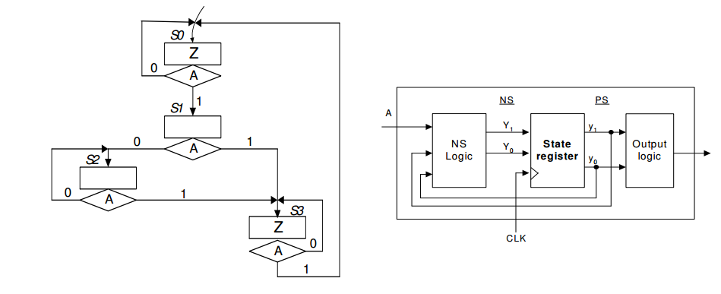
Example : Verilog Modeling of an FSM (version A coding).

Slide 22
module FSM1 ( A, CLK, reset, Z );
input A, CLK, reset ;
outputZ ;
reg [1:0] y, Y ;
parameter [1:0] S0 = 2’b00, S1 = 2’b01, S2 = 2’b10, S3 = 2’b11;
// NS logic module:
always @ (A or y)
case ( y)
S0 : if( A ) Y = S1; elseY = S0;
S1 : if( A ) Y = S3; elseY = S2;
S2 : if( A ) Y = S3; elseY = S2;
S3 : if( A ) Y = S0; elseY = S3;
endcase
// state register module:
always @ ( negedgereset or posedgeCLK )
if(!reset ) y <= S0 ;
elsey <= Y ;
// define the Output Logic:
assign Z = ( y == S0 ) | (y == S3) ;
endmodule

Slide 23
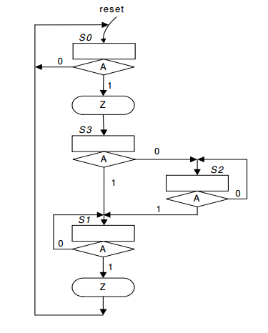
Example : Verilog Modeling of FSM (version B coding).

Slide 24
module FSM2 ( A, CLK, reset, Z );
input A, CLK, reset ;
output Z ;
reg [1:0] y, Y ;
parameter [1:0] S0 = 0, S1 = 1, S2 =2, S3=3;
// define STATE_REG:
always @(negedge reset or negedge CLK)
if( reset == 0 ) y <= A ;
else y <= Y ;
// define NS_OUTPUT and OUTPUT LOGIC:
always @( y or A )
begin
case( y )
S0 : if (A )begin Y = S3 ; Z = 1; end
else begin Y = S0 ; Z = 0; end
S1 : if( A )begin Y = S0 ; Z = 1; end
else begin Y = S1 ; Z = 0; end
S2 : if ( A )begin Y = S1 ; Z = 0; end
else begin Y = S2 ; Z = 0; end
S3 : if ( A )begin Y = S1 ; Z = 0; end
else begin Y = S2 ; Z = 0; end
endcase
end
endmodule

